Slide 1

Using GitHub Enterprise Repositories as Document Libraries for Economic Research Data
Managing economic data effectively with GitHub tools
Notes:
AI-generated content may be incorrect. --- This presentation provides an in-depth look at utilizing GitHub Enterprise repositories as effective document libraries for managing economic research data. We'll explore the capabilities, roles, and strategies involved in collaborating on research data within GitHub Enterprise.

Slide 2

Demonstration of GitHub Enterprise Use Case
Overview of how GitHub Enterprise supports research data management.
Step-by-step demonstration of setting up repositories.
Collaboration features that enhance team efficiency.
Notes:
This slide will feature a 5-minute video demonstrating practical use cases of GitHub Enterprise repositories. The video will showcase how to set up repositories, manage access controls, and utilize collaboration tools effectively within the context of economic research data management.

Slide 3

Agenda Overview
Introduction to GitHub Enterprise
Repository Roles and Types
Creating and Managing Repositories
Collaborating on Economic Research Data
Distributing Economic Research Data
Use Cases and Scenarios
Demonstrations of Various GitHub Repository Roles and Types
Notes:
We will start with an introduction to GitHub Enterprise, discussing its features and benefits for document management. Next, we'll cover repository roles and types, followed by creating and managing repositories. The presentation will then delve into collaboration strategies on economic research data before exploring distribution methods, use cases, and concluding with demonstrations of various repository roles.

Slide 4
Introduction to GitHub Enterprise
Notes:
GitHub Enterprise is a powerful platform designed for organizations to manage projects and collaborate efficiently. It provides tools for version control, code management, and document storage, making it ideal for economic research data.

Slide 5

Overview of GitHub Enterprise
Secure Collaboration
GitHub Enterprise provides a secure platform for teams to collaborate on various projects while protecting sensitive information.
Deployment Flexibility
GitHub Enterprise can be deployed on-premises or in the cloud, offering flexibility for different organizational needs.
Security for Research Data
The platform ensures security for sensitive research data, making it suitable for organizations handling confidential information.
Notes:
GitHub Enterprise offers a secure environment for teams to store, share, and collaborate on projects. It can be deployed on-premises or as a cloud service, ensuring flexibility and security for sensitive research data.

Slide 6

Benefits of Using GitHub for Document Management
Enhanced Collaboration
GitHub allows multiple team members to collaborate seamlessly on documents, improving communication and productivity.
Version Control
With GitHub, teams can track changes and maintain different versions of documents, ensuring nothing is lost or overwritten.
Access to Historical Data
GitHub provides easy access to historical document data, allowing teams to revisit previous versions and decisions.
Streamlined Workflows
Using GitHub can streamline workflows by automating processes and integrating with other tools, enhancing efficiency.
Notes:
Using GitHub for document management provides several advantages, including enhanced collaboration, version control, easy access to historical data, and streamlined workflows. This is particularly beneficial for research teams working on complex economic projects.

Slide 7

Setting up GitHub Enterprise for Your Organization
User Roles Configuration
Establishing user roles is essential for managing access and responsibilities in GitHub Enterprise effectively.
Repository Settings
Configuring repository settings allows you to tailor the storage and management of your data according to your organization's requirements.
Permissions Management
Setting up permissions ensures secure data management and controls who can access and modify information.
Notes:
Setting up GitHub Enterprise involves configuring the platform to meet your organization's needs. This includes establishing user roles, repository settings, and permissions to ensure secure and efficient data management.

Slide 8
Repository Roles and Types
Notes:
Understanding the different types of repositories and user roles is crucial for effective collaboration within GitHub Enterprise. Each role has distinct responsibilities and access levels to ensure proper management of research data.

Slide 9
Types of Repositories (Public, Private, Internal)
Public Repositories
Public repositories allow open collaboration, making it easier for developers to work together on shared projects.
Private Repositories
Private repositories are designed for sensitive projects, ensuring that only authorized users have access to the code.
Internal Repositories
Internal repositories are accessible only within an organization, facilitating secure collaboration among team members.
Notes:
GitHub supports various repository types: public repositories for open collaboration, private repositories for sensitive projects, and internal repositories that are accessible only within the organization. Choosing the right type is essential for data protection.

Slide 10

Roles Within a Repository (Owner, Collaborator, Contributor)
Role of Owner
The owner of a repository has full control over its contents and settings, making critical decisions.
Role of Collaborator
Collaborators can contribute and manage content within the repository, working closely with the owner.
Role of Contributor
Contributors submit changes and improvements to the repository, playing an important role in its development.
Notes:
Roles within a repository include the owner, who has full control; collaborators, who can contribute and manage content; and contributors, who can submit changes. Understanding these roles helps in managing workflow and contributions effectively.

Slide 11

Permissions and Access Control
User Access Levels
Establishing clear user access levels ensures that individuals can only access data relevant to their roles.
Data Integrity
Proper access controls help maintain data integrity by preventing unauthorized modifications or deletions.
Collaborative Security
In collaborative research projects, effective permissions ensure that sensitive data is protected while facilitating teamwork.
Notes:
Effective permissions and access control mechanisms ensure that users have the appropriate level of access to repository content. This is crucial for maintaining data integrity and security within collaborative research projects.

Slide 12
Creating and Managing Repositories
Notes:
Creating and managing repositories is a fundamental task in GitHub Enterprise. This section will guide you through the steps to establish a new repository and manage its contents effectively.

Slide 13

Creating a New Repository
Repository Details
Users need to specify important details like the repository name and type to set up successfully.
Public vs. Private
Choosing between public or private repositories is crucial for data accessibility and privacy management.
Initial Settings
Setting initial configurations is essential to organize and store research data effectively.
Notes:
To create a new repository, users must specify key details such as the repository name, type (public or private), and initial settings. This setup is the foundation for organizing and storing research data.

Slide 14

Organizing Repository Contents
Logical Structure
A logical structure is crucial for organizing repository contents effectively, ensuring files and folders are easily navigable.
Ease of Access
Organized contents allow team members to quickly locate important documents and datasets, increasing productivity.
Collaborative Efficiency
Enhancing collaboration efficiency becomes easier when repository contents are structured logically and consistently.
Notes:
Organizing repository contents involves structuring files and folders in a logical manner. This makes it easier for team members to locate and manage documents and datasets, enhancing collaboration efficiency.

Slide 15

Managing Repository Settings
Access Controls Configuration
Configuring access controls ensures that only authorized users can interact with the repository, enhancing security.
Webhooks Setup
Setting up webhooks allows real-time communication between the repository and other services, facilitating integrations.
Integration Options
Integrating external tools with the repository can streamline workflows and improve overall performance.
Notes:
Managing repository settings includes configuring access controls, webhooks, and integration options. Proper management of these settings is key to optimizing repository performance and security.

Slide 16
Collaborating on Economic Research Data
Notes:
Collaboration is at the heart of using GitHub for economic research. This section will focus on techniques for effective collaboration, including version control, branching, and merging strategies.

Slide 17

Version Control and Commit History
Tracking Changes
Version control enables teams to track changes made to documents or code, ensuring transparency in the editing process.
Commit History
Maintaining a commit history helps teams understand the evolution of a project, showing what changes were made and why.
Reverting Changes
Version control systems allow users to revert to previous versions, which is essential for maintaining data integrity and correcting errors.
Importance in Research
In research, version control is crucial for preserving data integrity and ensuring that changes can be tracked reliably.
Notes:
Version control allows teams to track changes, maintain a history of edits, and revert to previous versions if necessary. This is especially important in research where data integrity must be preserved.

Slide 18

Branching and Merging Strategies
Understanding Branching
Branching enables researchers to work on separate features or fixes independently, preserving the integrity of the main codebase.
Importance of Merging
Merging consolidates changes from various branches into the main codebase, ensuring all updates are integrated effectively.
Notes:
Branching allows researchers to work on different aspects of a project without affecting the main codebase. Merging is the process of integrating changes from different branches, which is critical for collaborative efforts.

Slide 19

Using Pull Requests for Collaboration
Collaboration Tool
Pull requests enable team members to collaborate effectively by proposing and discussing changes before implementation.
Quality Control
The pull request process enhances quality control by allowing for code review and discussion before merging changes.
Enhanced Communication
Pull requests foster better communication among team members, ensuring everyone is on the same page.
Notes:
Pull requests are a valuable tool for collaboration, allowing team members to propose changes and discuss them before merging. This process fosters communication and quality control in research projects.

Slide 20
Distributing Economic Research Data
Notes:
Once research data is organized and managed, distributing it effectively is crucial. This section will explore methods for sharing data both internally and externally.

Slide 21

Publishing Data to Public Repositories
Wider Dissemination
Publishing data to public repositories allows researchers to share their findings with a broader audience, enhancing collaboration.
Data Privacy Considerations
It's crucial to address data privacy concerns before making any dataset publicly available, ensuring sensitive information is protected.
Intellectual Property Issues
Researchers must consider intellectual property rights when publishing data, to avoid potential legal complications.
Notes:
Publishing data to public repositories enables wider dissemination of research findings. However, it's important to consider data privacy and intellectual property before making data public.

Slide 22
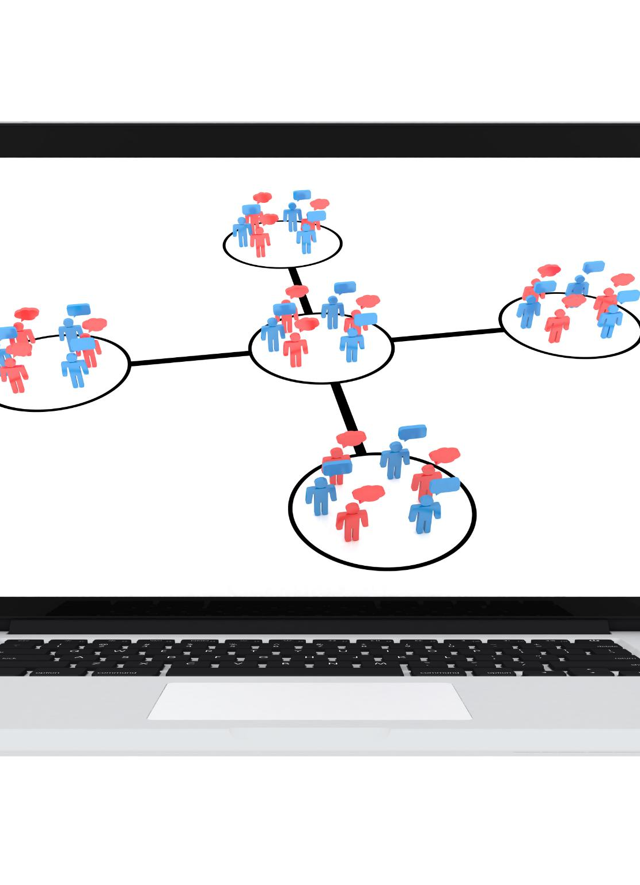
Sharing Data Within the Organization
Fostering Collaboration
Sharing data internally encourages teamwork and enhances collaborative efforts among team members.
Internal Repositories
Setting up internal repositories allows secure and organized access to essential data for various projects.
Secure Data Access
Ensuring secure access to data helps protect sensitive information while promoting effective project management.
Notes:
Sharing data internally fosters collaboration among team members. Setting up private or internal repositories can facilitate secure access to necessary data for ongoing projects.

Slide 23

External Collaboration and Sharing with Stakeholders
Importance of External Engagement
Engaging with external partners enhances the quality and impact of research projects through diverse perspectives and expertise.
Secure Data Sharing
Sharing data securely is essential to protect sensitive information while collaborating with stakeholders.
Regulatory Compliance
Ensuring compliance with regulations is critical when collaborating and sharing data with external stakeholders.
Notes:
Engaging with external partners and stakeholders is vital for enriching research projects. This involves sharing data securely while ensuring compliance with relevant regulations.

Slide 24
Use Cases and Scenarios
Notes:
Exploring practical use cases can illustrate the effectiveness of GitHub Enterprise for economic research. This section will delve into various scenarios where GitHub can enhance collaboration and data management.

Slide 25

Internal Collaboration on Research Projects
Efficient Project Management
GitHub Enterprise provides tools that enhance the management of research projects, ensuring that teams work efficiently and effectively.
Insight Sharing
The platform facilitates the sharing of insights among team members, fostering a collaborative research environment.
Contribution Tracking
With GitHub Enterprise, teams can maintain a clear record of contributions, ensuring accountability and transparency in research.
Notes:
GitHub Enterprise is ideal for internal collaboration, enabling teams to manage research projects efficiently, share insights, and maintain a clear record of contributions.

Slide 26

Public Dissemination of Research Findings
Organized Repositories
Well-organized repositories serve as valuable platforms for disseminating research findings, enhancing their visibility and accessibility.
Increasing Visibility
Dissemination of research findings increases their visibility, leading to greater public awareness and engagement with science.
Encouraging Transparency
Transparent sharing of research findings fosters trust and accountability within the research community and among the public.
Notes:
Research findings can be disseminated to the public through well-organized repositories, increasing visibility and impact. This process encourages transparency and accessibility in research.

Slide 27

Case Study: Collaborative Research with External Partners
Successful Collaboration
This case study highlights how collaborative research can lead to successful outcomes when using GitHub Enterprise.
External Partner Contributions
External partners played a crucial role in the project, enhancing the overall quality and innovation of the research.
Benefits of GitHub Enterprise
Using GitHub Enterprise fosters collaboration by providing a platform for efficient communication and project management among partners.
Notes:
A case study can highlight successful collaborative research using GitHub Enterprise. By detailing how external partners contributed to a project, we can showcase the benefits of the platform in fostering collaboration.

Slide 28
Demonstrations of Various GitHub Repository Roles and Types
Notes:
Demonstrating the different repository roles and types can provide practical insights into their functionalities. This section will focus on setting up, managing, and collaborating within various repository configurations.

Slide 29

Demonstration: Setting up a Public Repository
Configuring Repository Settings
Learn how to configure various settings for your public repository to ensure proper functionality and accessibility.
Adding Files to Repository
Understand the process of adding files to your public repository and organizing them effectively for better management.
Managing Access
Learn how to manage access permissions for your repository, allowing contributors to collaborate effectively.
Notes:
In this demonstration, we will walk through the steps of setting up a public repository. Attendees will learn how to configure settings, add files, and manage access to the repository.

Slide 30

Demonstration: Managing a Private Repository
User Roles in Repositories
Understanding user roles is crucial for managing access in a private repository. Different roles dictate levels of access and responsibility.
Setting Permissions
Properly setting permissions ensures that only authorized users can access sensitive data, protecting the repository from unauthorized access.
Security Settings Overview
Implementing security settings is essential to safeguard data within a private repository, mitigating risks of data breaches.
Notes:
This demonstration will cover the management of a private repository, focusing on user roles, permissions, and security settings to ensure sensitive data remains protected.

Slide 31

Demonstration: Collaborating in an Internal Repository
Effective Collaboration
Learn the best practices for collaborating on code within an internal repository to improve project outcomes.
Branching Strategies
Understand how to use branching strategies to work on features independently without affecting the main codebase.
Merging Changes
Explore how to merge changes effectively to integrate new features and updates into the main repository.
Pull Requests
Learn about the importance of pull requests for code review and ensuring quality before merging changes.
Notes:
We will demonstrate how to collaborate effectively within an internal repository. Participants will see how to use features like branching, merging, and pull requests to enhance teamwork.

Slide 32
Conclusion
Benefits of GitHub Enterprise
Utilizing GitHub Enterprise for economic research data enhances collaboration and efficiency within research teams.
Best Practices in Management
Implementing best practices in repository management ensures data integrity and accessibility for all users.
Enhanced Research Capabilities
By leveraging GitHub Enterprise, organizations can significantly improve their research capabilities and outcomes.
Notes:
Using GitHub Enterprise repositories as document libraries for economic research data offers substantial benefits. By following best practices in repository management, collaboration, and data distribution, organizations can significantly enhance their research capabilities.

